Slide 1
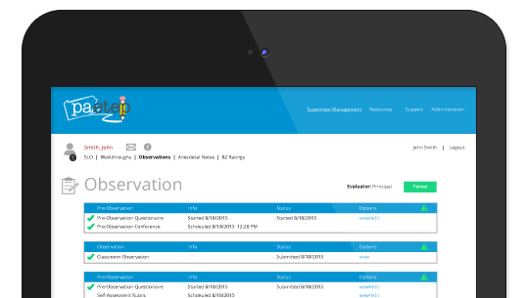
PA-ETEP Overview
Overview for Teachers and NTPEs

Slide 2
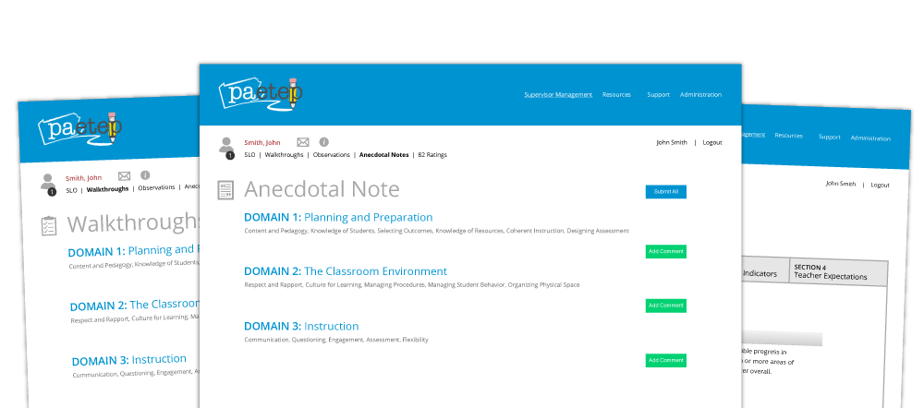
Table of Contents
Registration
Portal Navigation
Email Notifications
Student Performance Measures
Formal Observations
Differentiated Observations
Walkthroughs
Anecdotal Notes
13 Summative Rating Forms
NTPE Observations
Help and Support

Slide 3
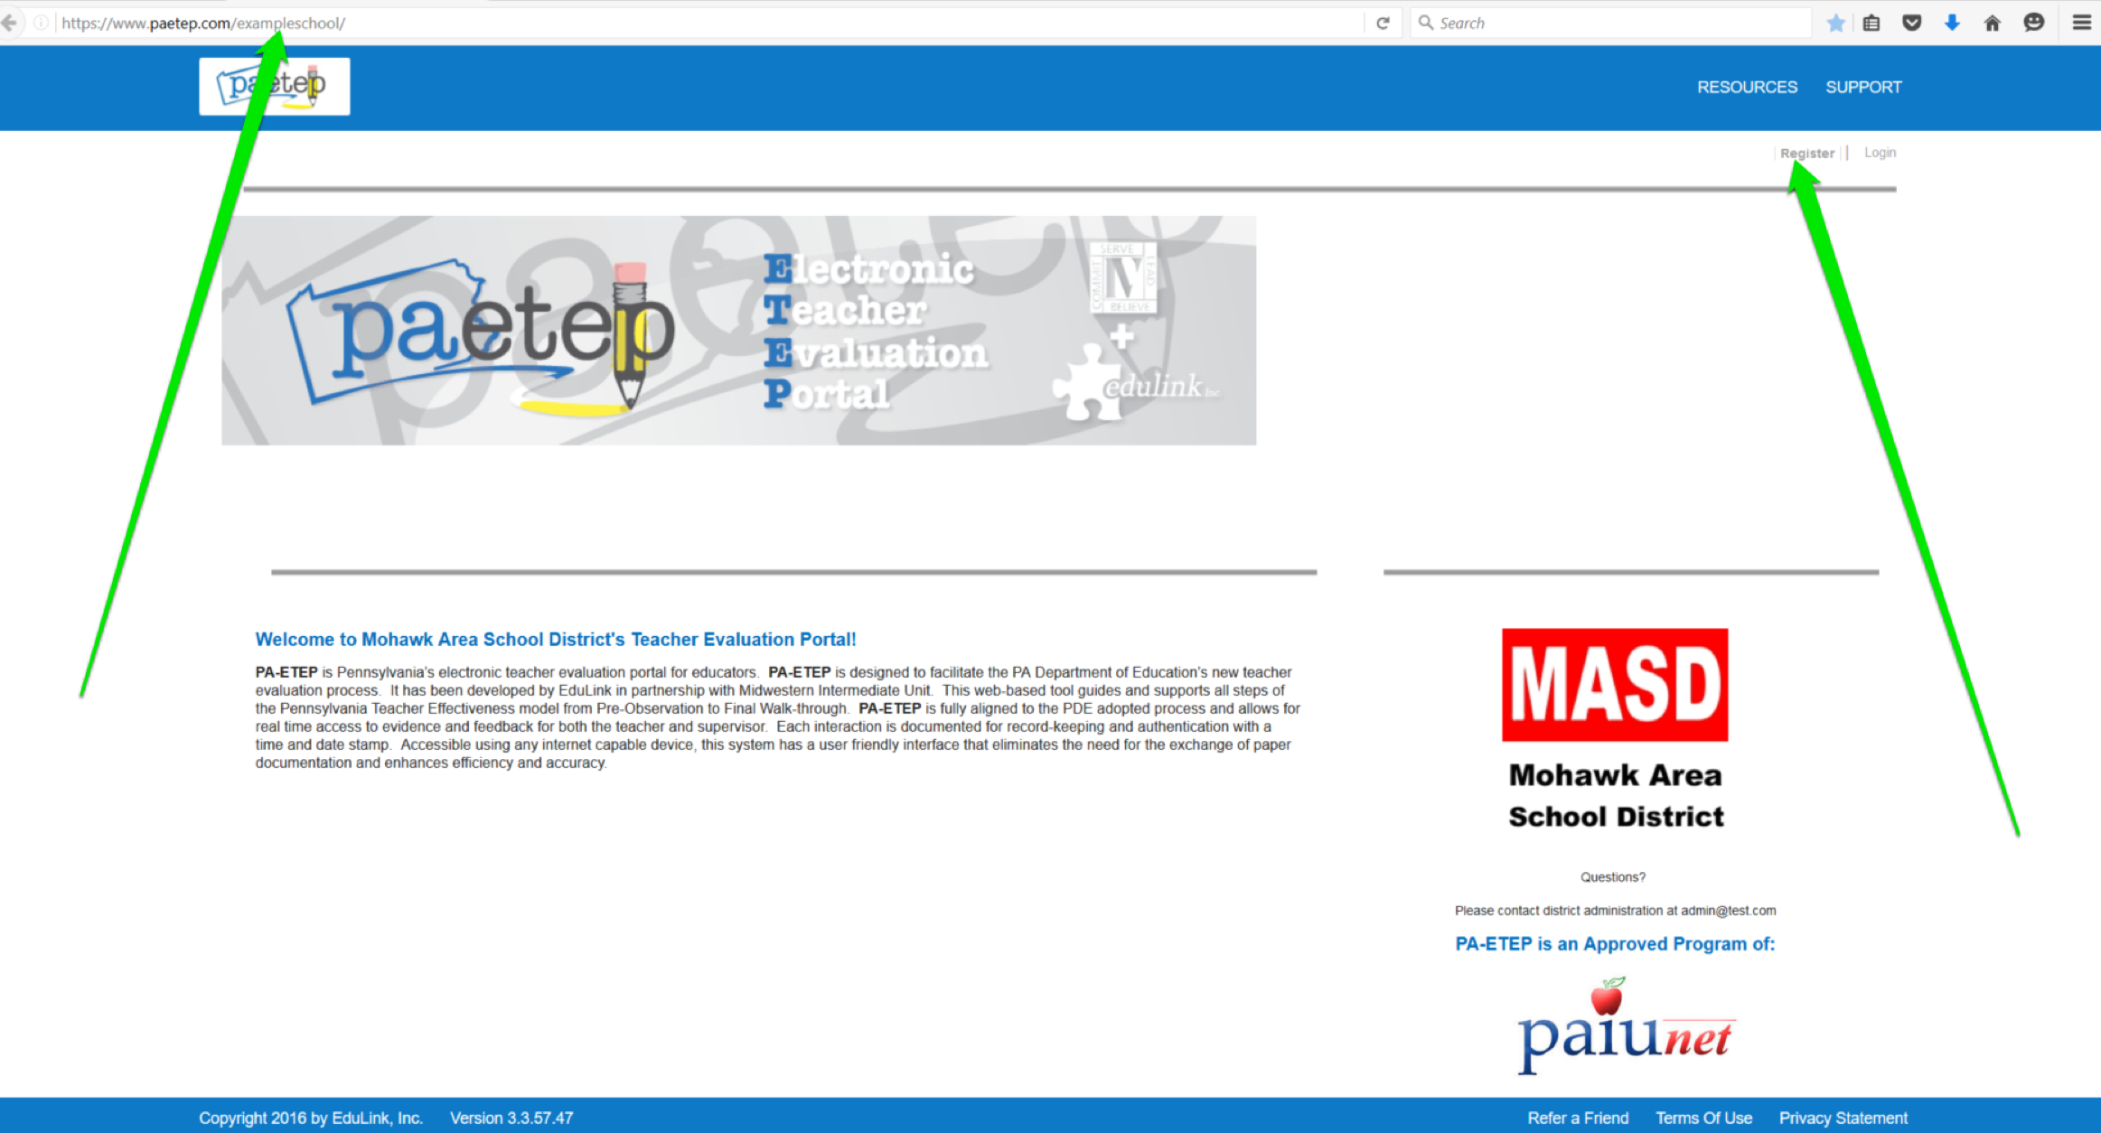
Registration
Each district has their own unique PA-ETEP portal:
www.paetep.com/nameofyourschooldistrict/
New teachers and non-teaching professionals (NTPEs) self-register on their district’s PA-ETEP portal
How to Register Video, click here

Slide 4
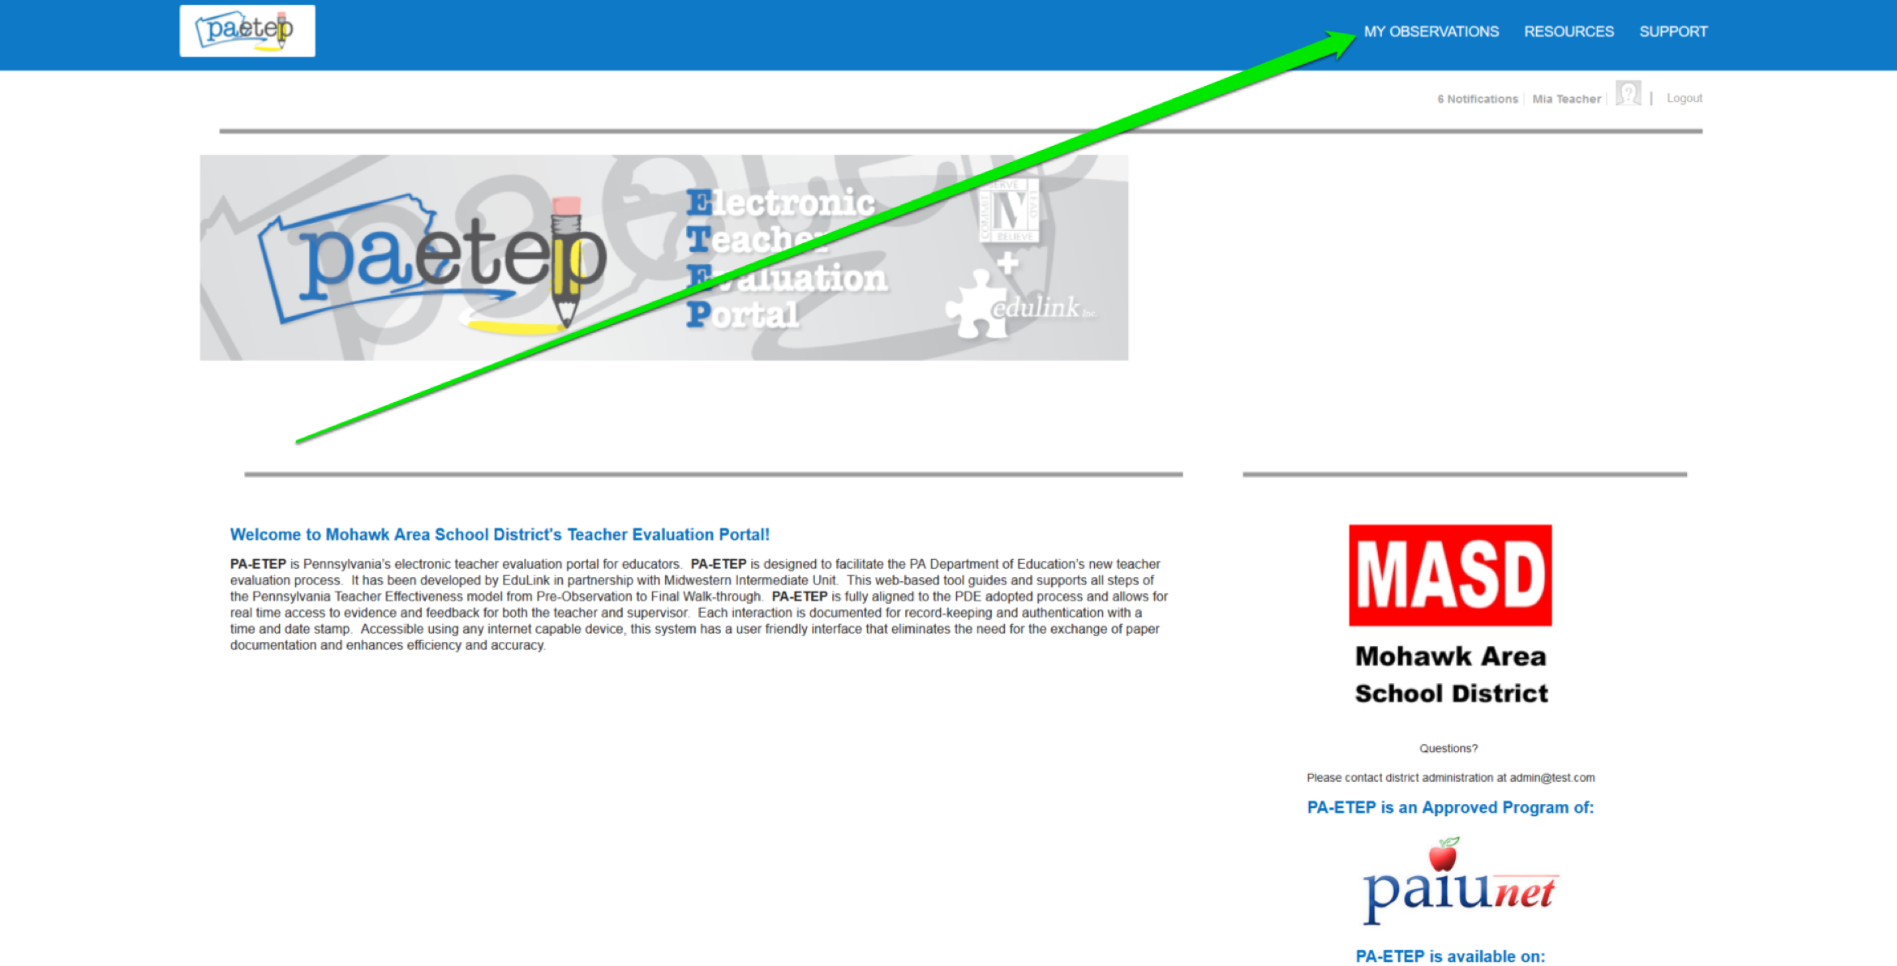
Portal Navigation
Once logged in, teachers and NTPEs should access their My Observations page to view items…
Student Performance Measure (SPM)
IEP Goals Progress (IEP)
Formal Observations
Differentiated Observations
NTPE Observations
Walkthroughs
Anecdotal Notes
13 Rating Forms

Slide 5
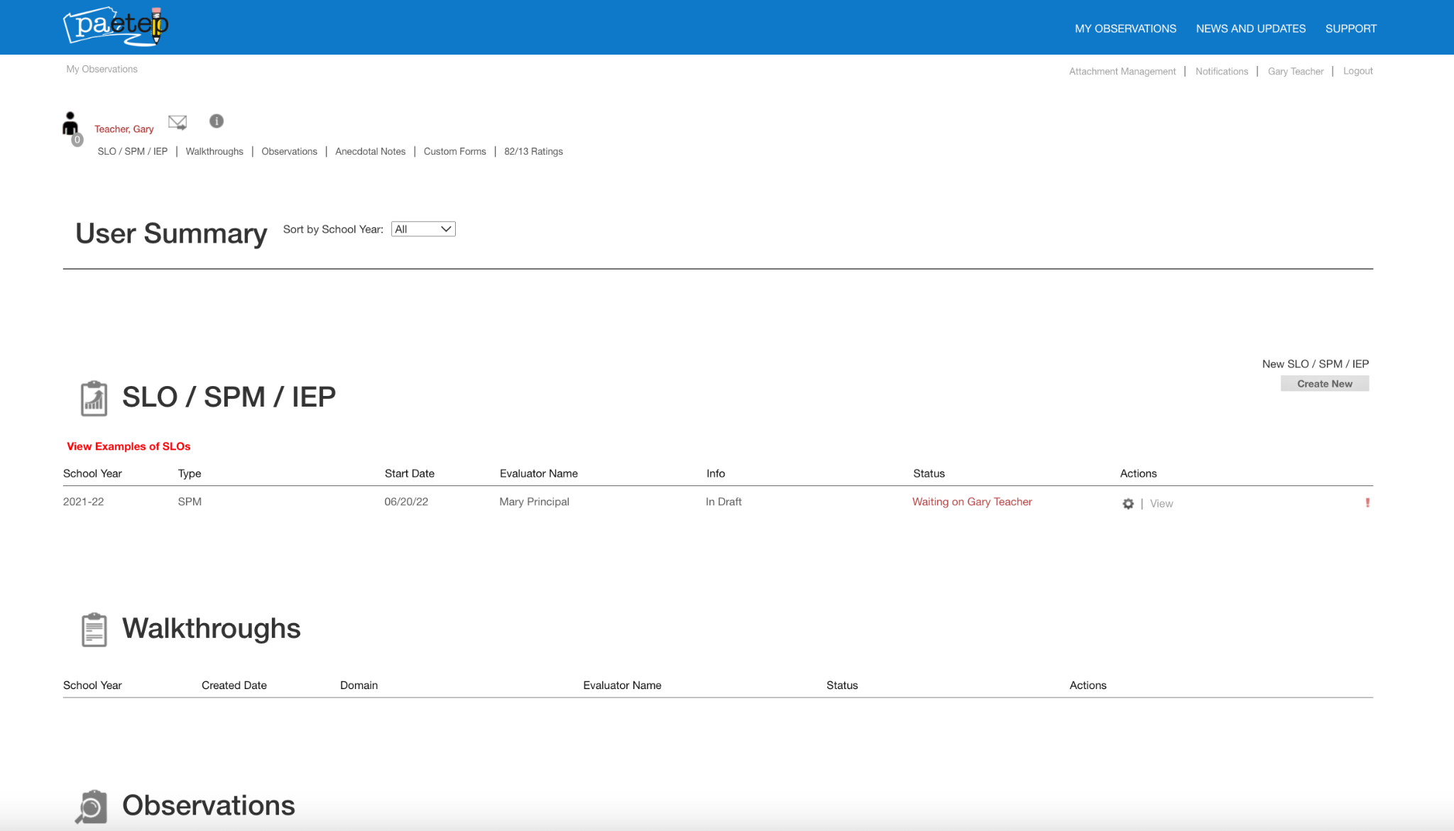
My Observations
On the My Observations or User Summary page, teachers and NTPEs can access open items and/or start new items by scrolling down to the appropriate section or clicking on the section quick links.

Slide 6
My Observations (continued)
Some items are initiated by Teachers/NTPEs and some are initiated by Supervisors.
Initiated by Teachers/NTPEs
Student Performance Measures (SPM)
IEP Goals Progress (IEP)
NTPE Observations (NTPE initiates)
Anecdotal Notes
Initiated by Supervisors
Formal Observations
Differentiated Observations
Walkthroughs
Anecdotal Notes
13 Forms

Slide 7
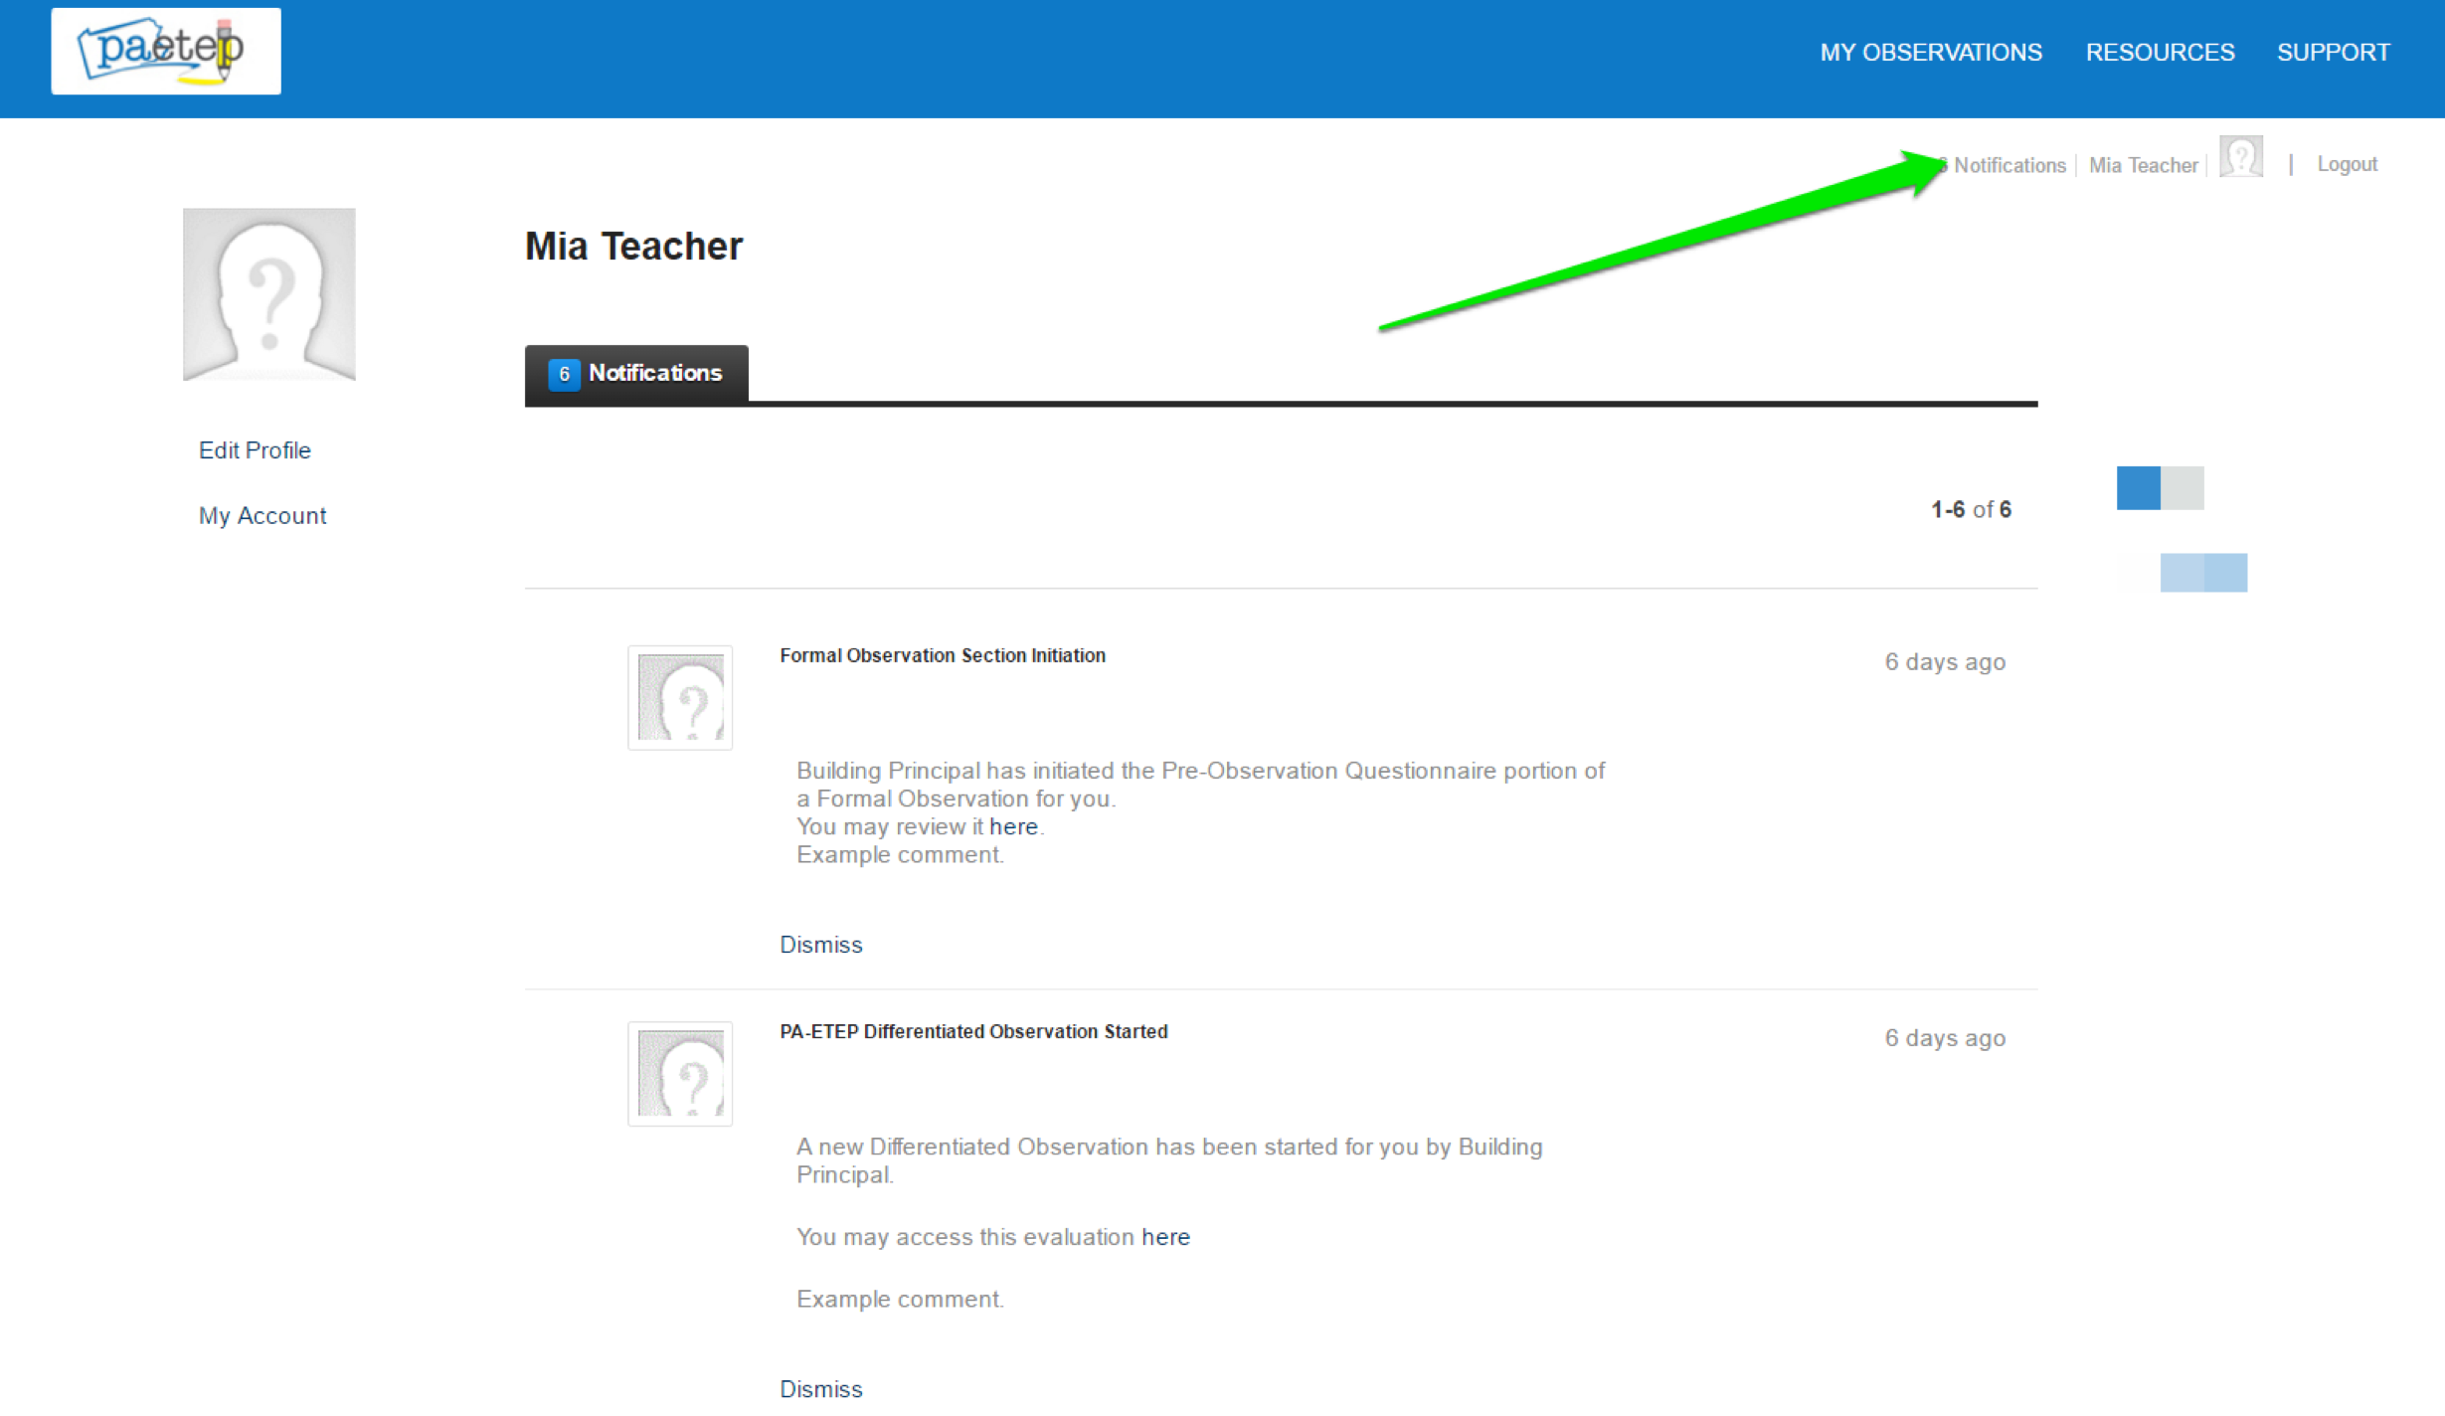
Email Notifications
PA-ETEP sends out email notifications each time a user (i.e., teacher, NTPE, and/or supervisor) completes and submits a step in a process.
For example, when a teacher completes and submits their Pre-Observation Questionnaire, the system sends an email notification to the assigned supervisor, notifying them of the submission. Once notified, the supervisor can then return to the item and review and add comments. When the supervisor submits those comments, an email notification is sent to the teacher informing them of the update.
In addition to email notifications, a copy of each notification is placed in the receiving users Notification section.

Slide 8
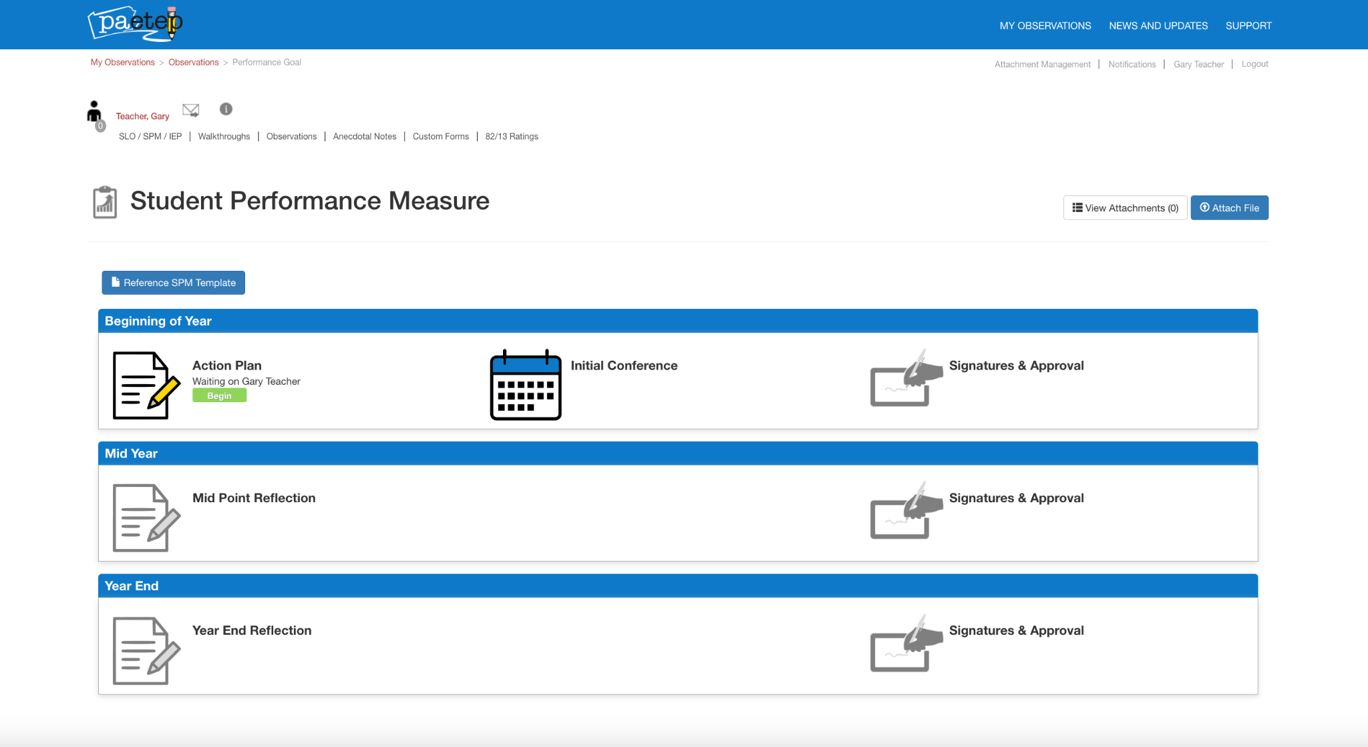
Student Performance Measure (SPM)
SPMs are initiated by the teacher.
When a teacher first starts an SPM, they are prompted to select the supervisor that will be responsible for reviewing and approving their SPM.
The SPM process has three main phases, including an initial action plan, mid-year update and year-end update. Each submission/update is reviewed and approved by the supervisor. Following the final update at the end of the year, the supervisor will enter a final score.

Slide 9
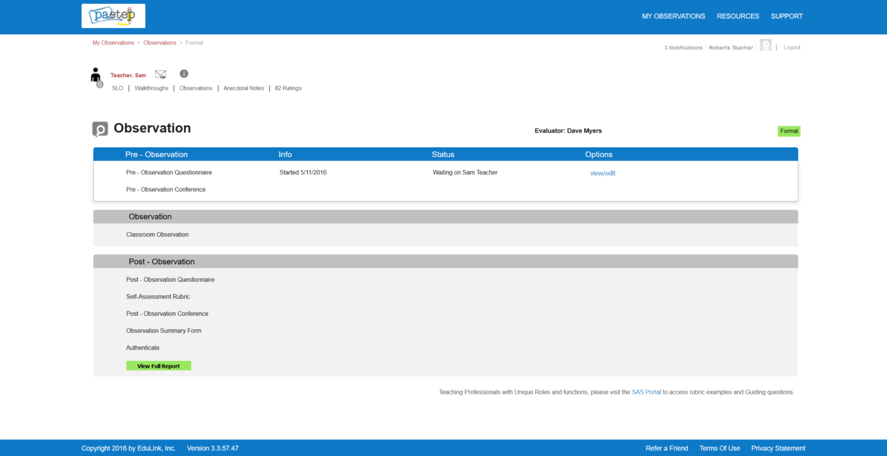
Formal Observations
Formal Observations are initiated by supervisors.
Teachers will receive an email notification when their supervisor initiates the formal observation process.
The Formal Observation has three main phases…
Pre-Observation
Pre-Observation Questionnaire
Pre-Observation Conference
Classroom Observation
Post-Observation
Post-Observation Questionnaire
Self-Assessment Rubric
Observation Summary Form
Post-Observation Conference

Slide 10
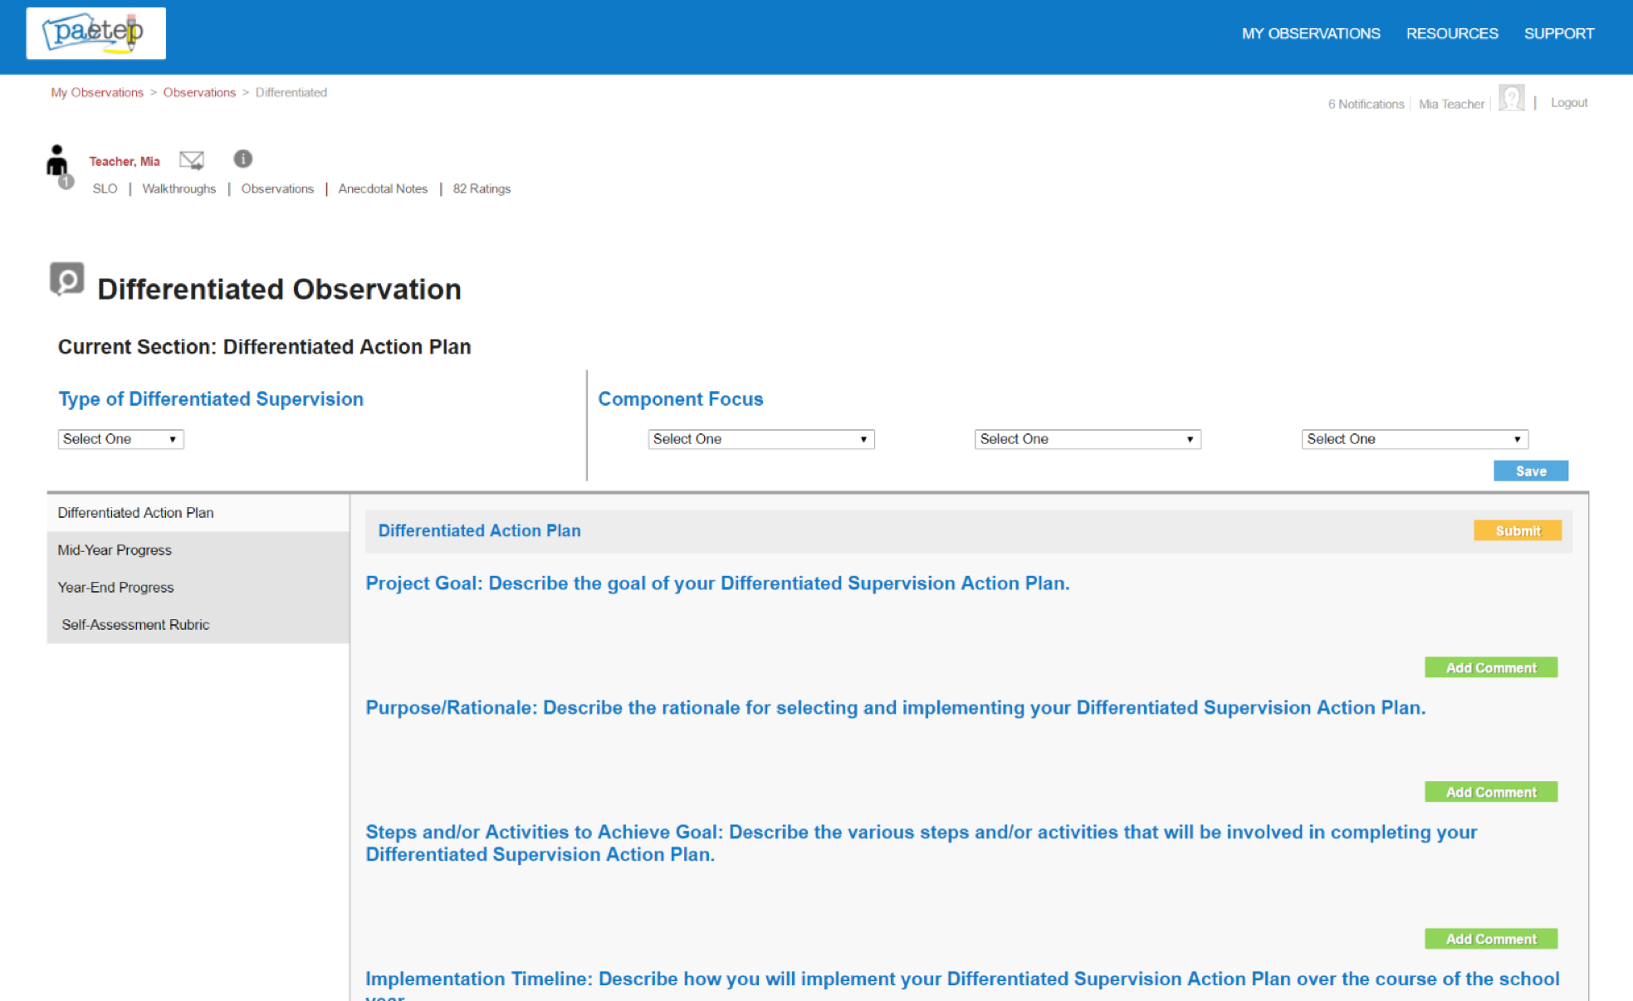
Differentiated Observations
Differentiated Observations are initiated by a supervisor.
Teachers will receive an email notification when a supervisor initiates the differentiated observation process.
The Differentiated Observation process has three main phases, including the Action Plan, Mid-Year Progress update, and Year-End Progress update / Self-Assessment Rubric rating.

Slide 11
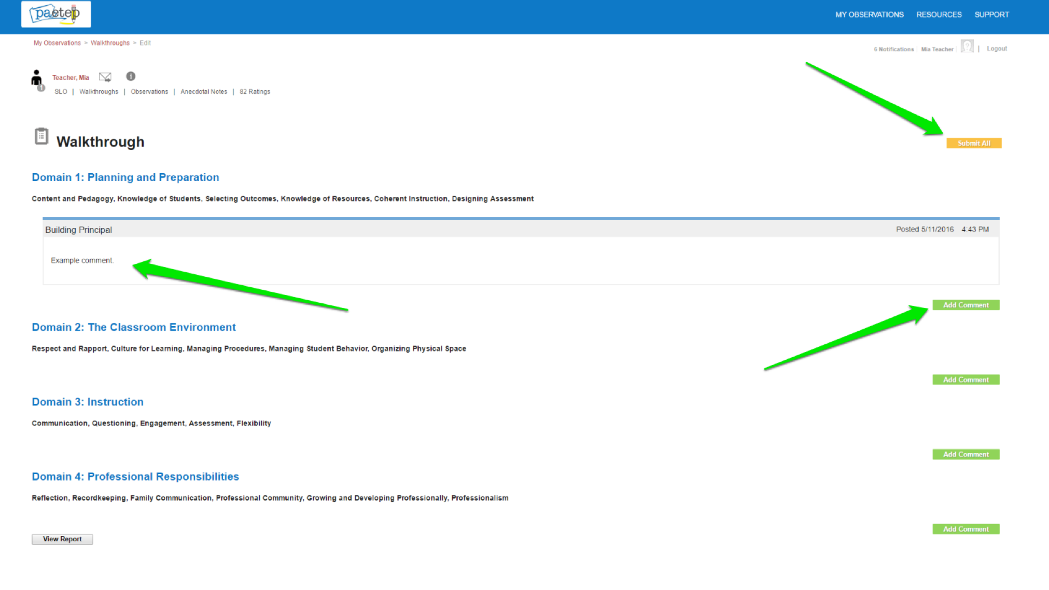
Walkthroughs
Walkthroughs are initiated by a supervisor.
Teachers/NTPEs will receive an email notification when a supervisor completes and submits a walkthrough.
Once submitted, the teacher/NTPE will have the option to review the evidence collected in the walkthrough and submit back to the supervisor any feedback and/or comments.

Slide 12
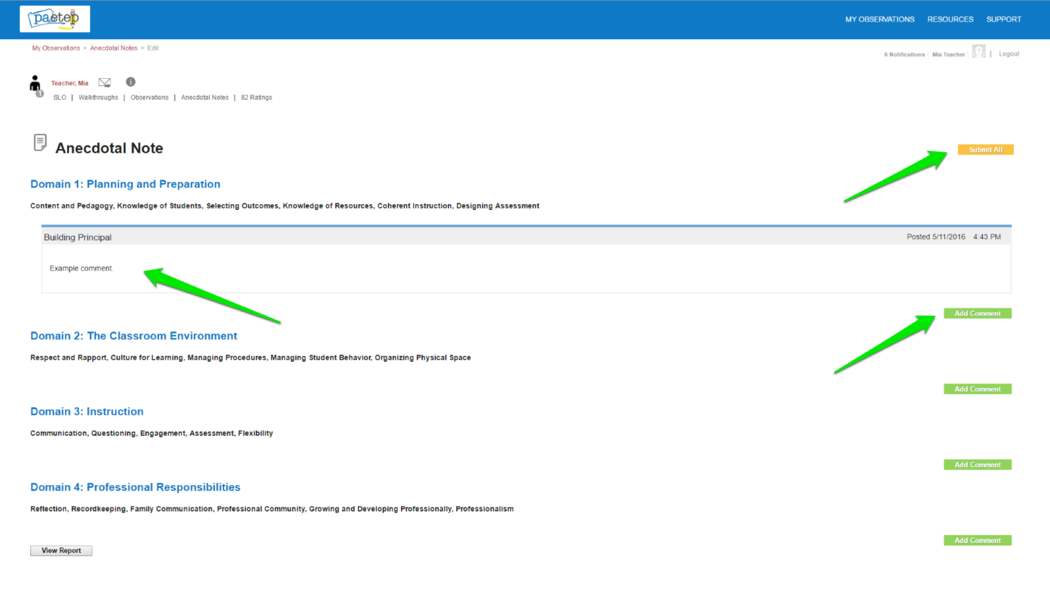
Anecdotal Notes
Anecdotal Notes are initiated by the supervisor and/or the teacher/NTPEs..
Anecdotal Notes offer users a place to document additional evidence that might not be captured during a Walkthrough or Formal Observation. For example, teachers can use an Anecdotal Note to share evidence about their practice, including authentic assessments, unit plans, communications with families, and any other pertinent information, allowing them to build a portfolio of artifacts. Supervisors can use Anecdotal Notes to document positive aspects about a teacher’s practice or leadership within the school/district. Once submitted, the other party has the option to review the evidence collected and submit back any feedback/comments.

Slide 13
13-1, 13-2, and 13-3 Annual Rating Forms
13-1 Rating Form for Classroom Teachers
13-2 Rating Form for Principals
Principals
Assistant/Vice Principals
CTC Directors
Directors of Special Education
13-3 Rating Form for Non-Teaching Professional Educators (NTPEs)
Educational Specialists
Instructional professionals other than classroom teachers
Supervisor professionals other than supervisors of special education

Slide 14
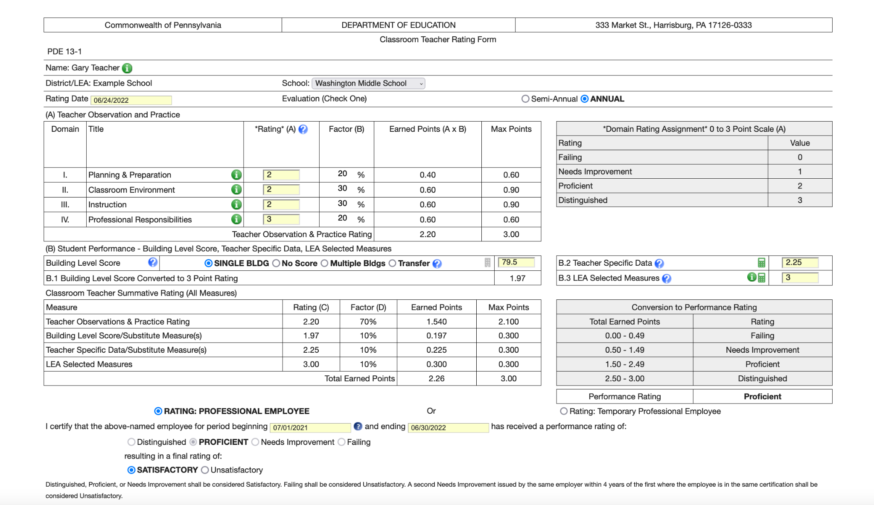
13-1 Annual Rating Forms

Slide 15
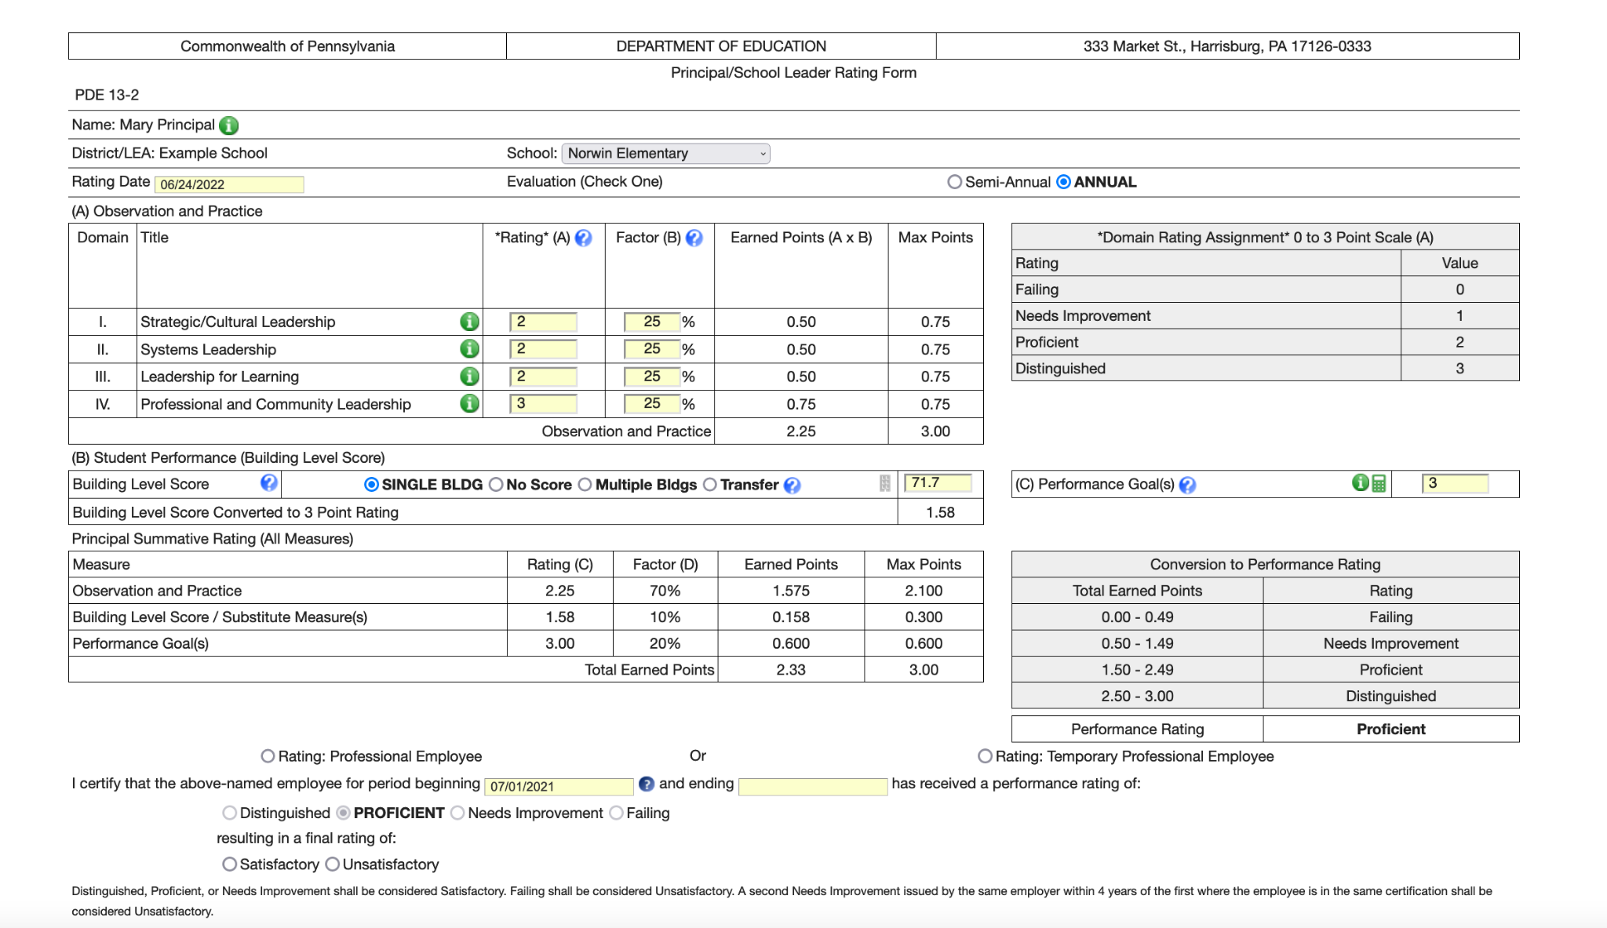
13-2 Annual Rating Forms

Slide 16
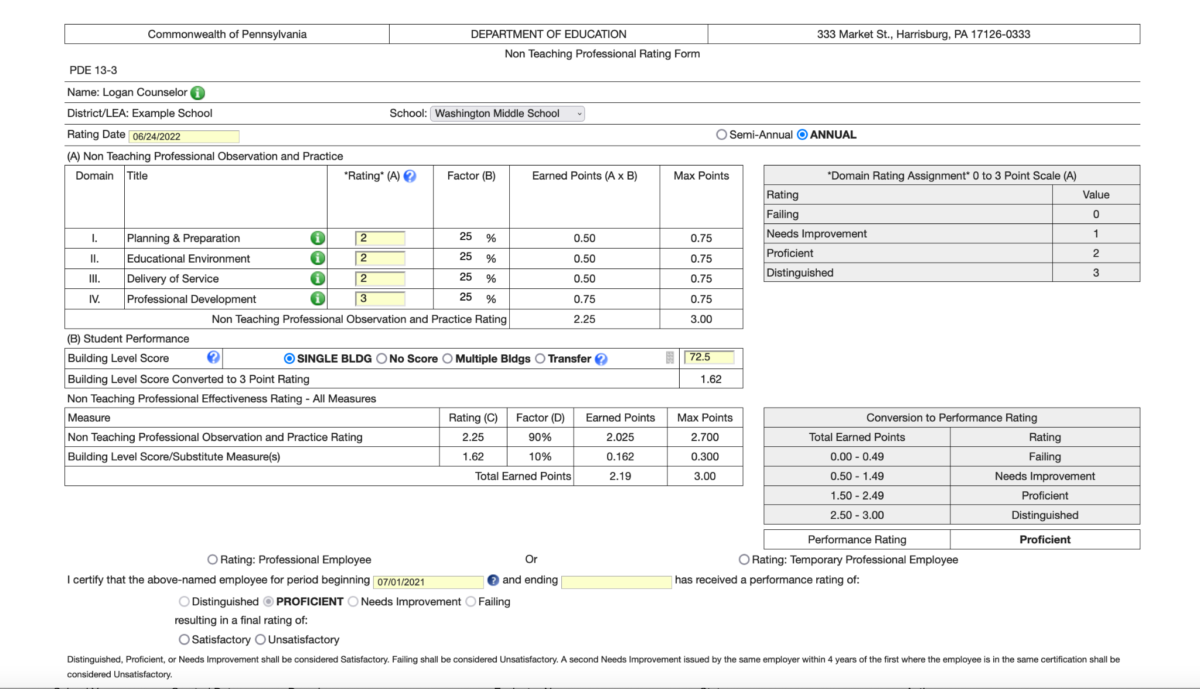
13-3 Annual Rating Forms

Slide 17
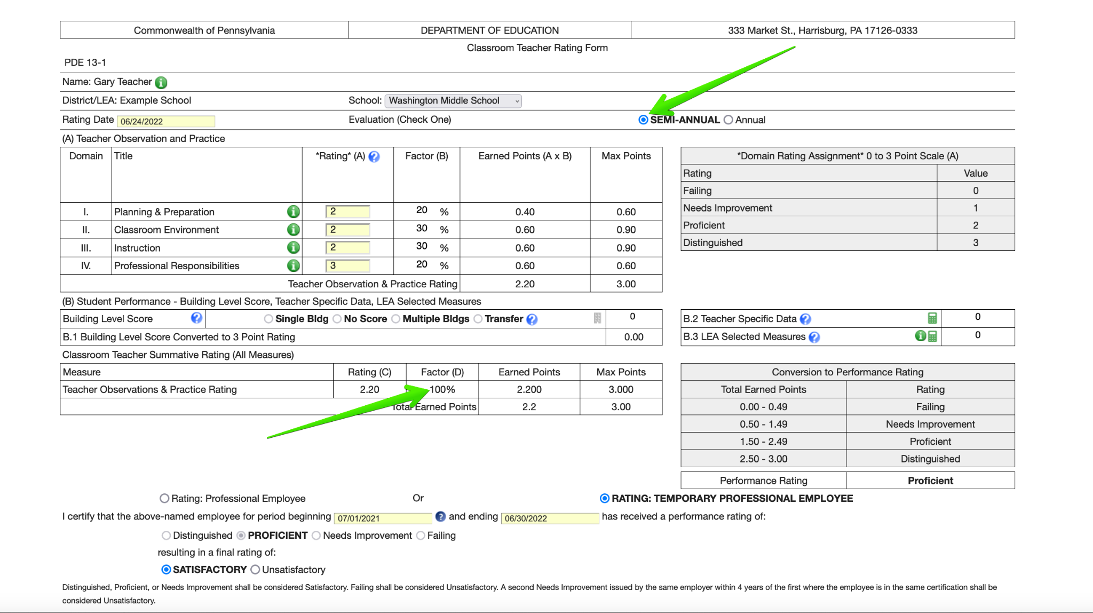
13-1 and 13-3 Semi-Annual Rating Forms
Semi Annual 13-1 and 13-3 rating forms should be completed twice per year for Temporary Professional Employees.
The final score on a Semi-Annual rating form is derived 100% from the Observation and Practice domain ratings.

Slide 18
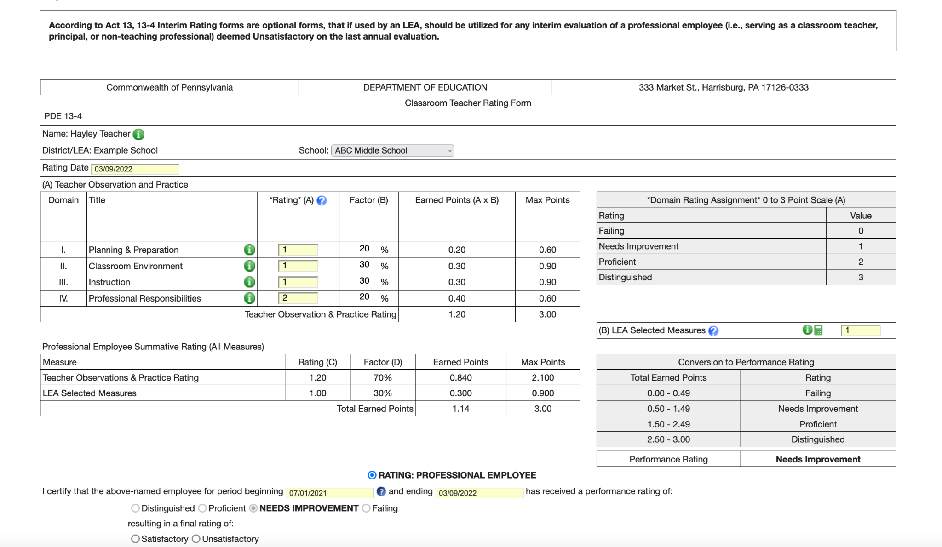
13-4 Interim Rating Forms
Professional employees who are considered unsatisfactory shall be rated at least annually. The first rating shall be calculated using the evaluation measures and weighting delineated in the rating tools as applicable to the employee (i.e., 13-1, 13-2, 13-3). Interim evaluations are not mandated; however, any interim rating of a professional employee who received an unsatisfactory rating on the annual evaluation shall be comprised of 70% Observation and Practice and 30% LEA Selected Measures, applying practice models, domain weighting and local measures as evaluated using the interim rating tool.

Slide 19
NTPE Observations
The NTPE Observation process is designed for non-supervising and supervising NTPEs.
Non-Supervising NTPEs
School Counselors
School Nurse
School Psychologist
Instructional Technology Specialist
Dental Hygienist
School Worker - Home School Visitor
Speech Language Pathologist
Supervising NTPEs
Supervisor of Curriculum and Instruction
Supervisor of Special Education
Supervisor of Pupil Services
Supervisor of Vocational Education
Building Principals

Slide 20
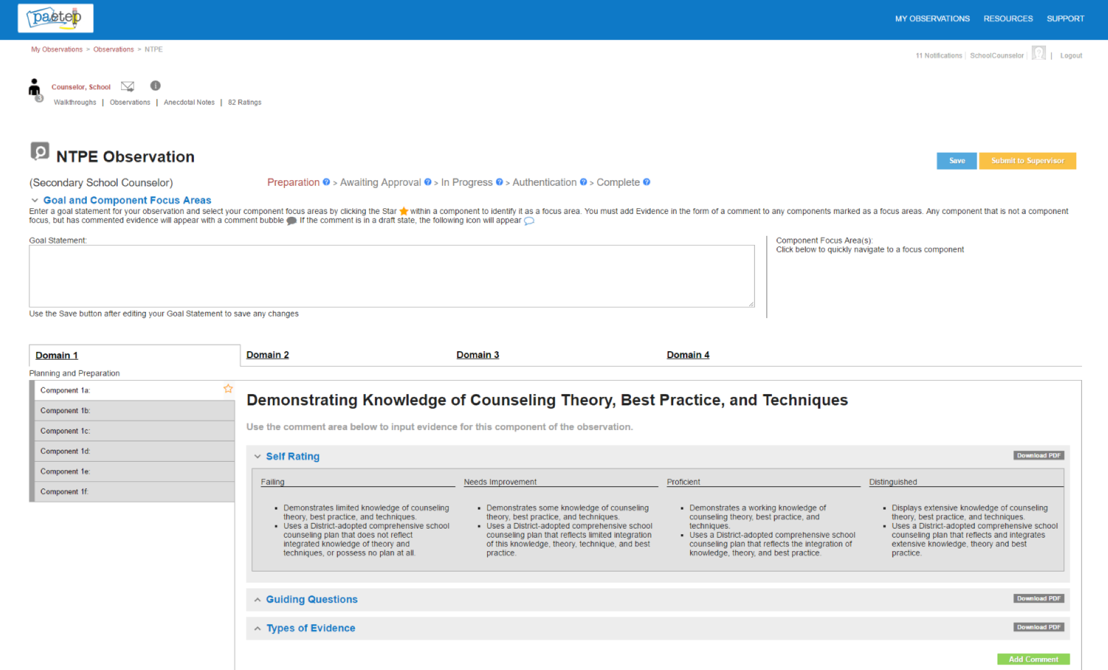
NTPE Observations
The NTPE Observation process is initiated by the NTPE.
When an NTPE starts the process, they are prompted to select the supervisor that will be responsible for reviewing and approving their NTPE Observation.
The NTPE Observation process has three main phases. Phase one includes goal setting, selecting component focus areas, adding evidence, and approval by a supervisor. Phase two involves ongoing updates throughout the school year. The final phase involves scoring of the self-assessment rubric.

Slide 21
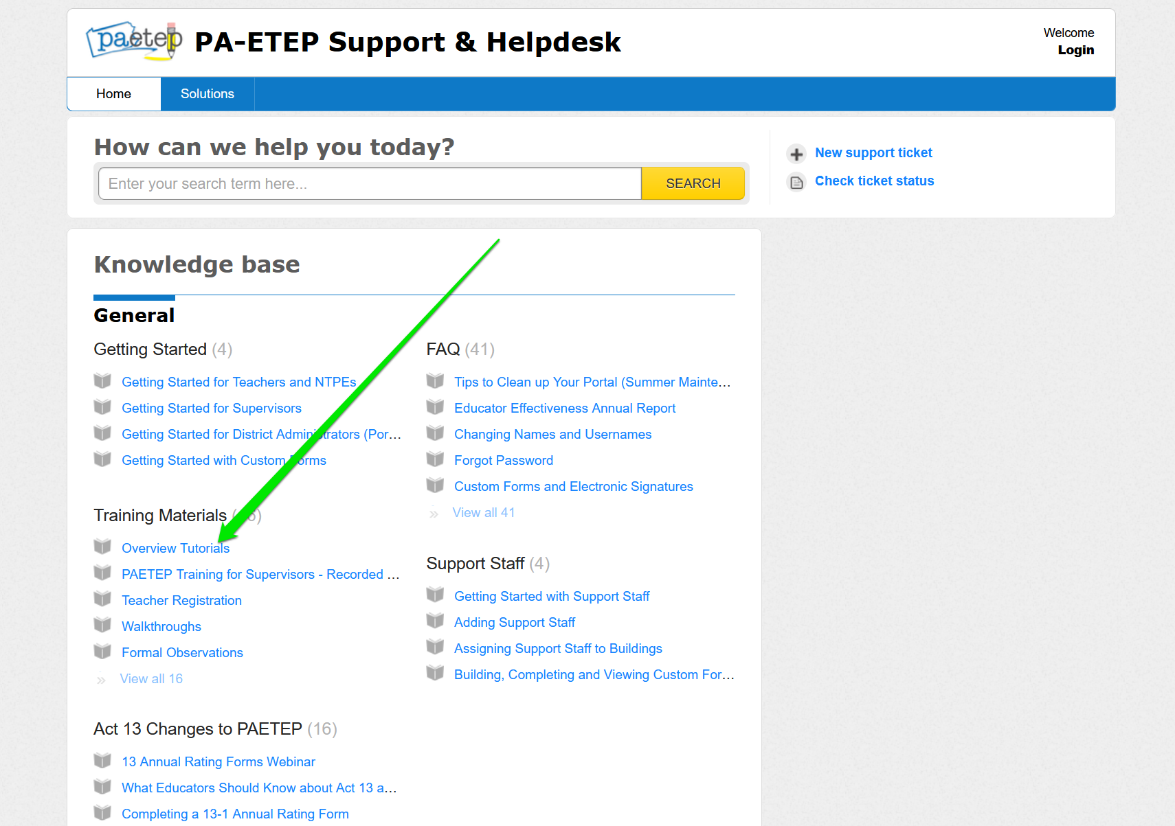
Learn More - Visit Support

